Slide 1
Sequence Analysis Server
Supervised by :
Dr :Heba zaki
Dr :Nora Abdelhameed
BY:
Hamza Abd Al-Azeem Mohamed
Hashem Amr Mohamed
Salma Nasser Shabaan
Mariam Mohamed Sobhi
Mariam Mohamed Abd AL-Dayem

Slide 2
Database Schema

Slide 3
Database Schema
This database consists of 2 tables :
Gene table contains five columns :
locus (primary key): uniquely identify each gene in this table
geneType
organism
refSeq
Seq
Gene table contains five columns :
accession (primary key): uniquely identify each gene in this table
geneLocus (foreign key): enforce a link between the two data
organism
pubmed
Seq

Slide 4
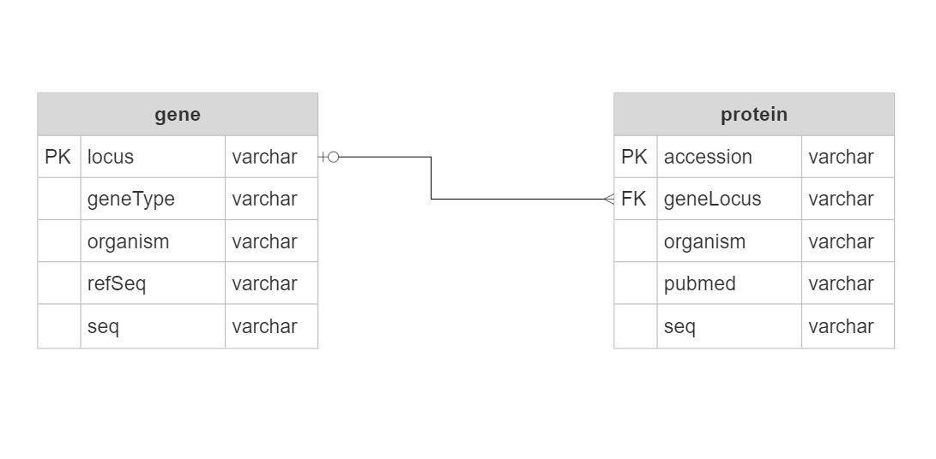

Slide 5
Database Manipuliation Functions

Slide 6
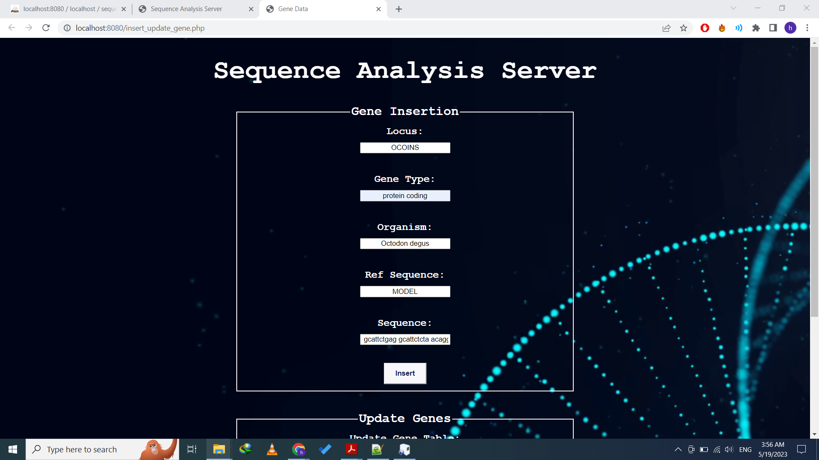
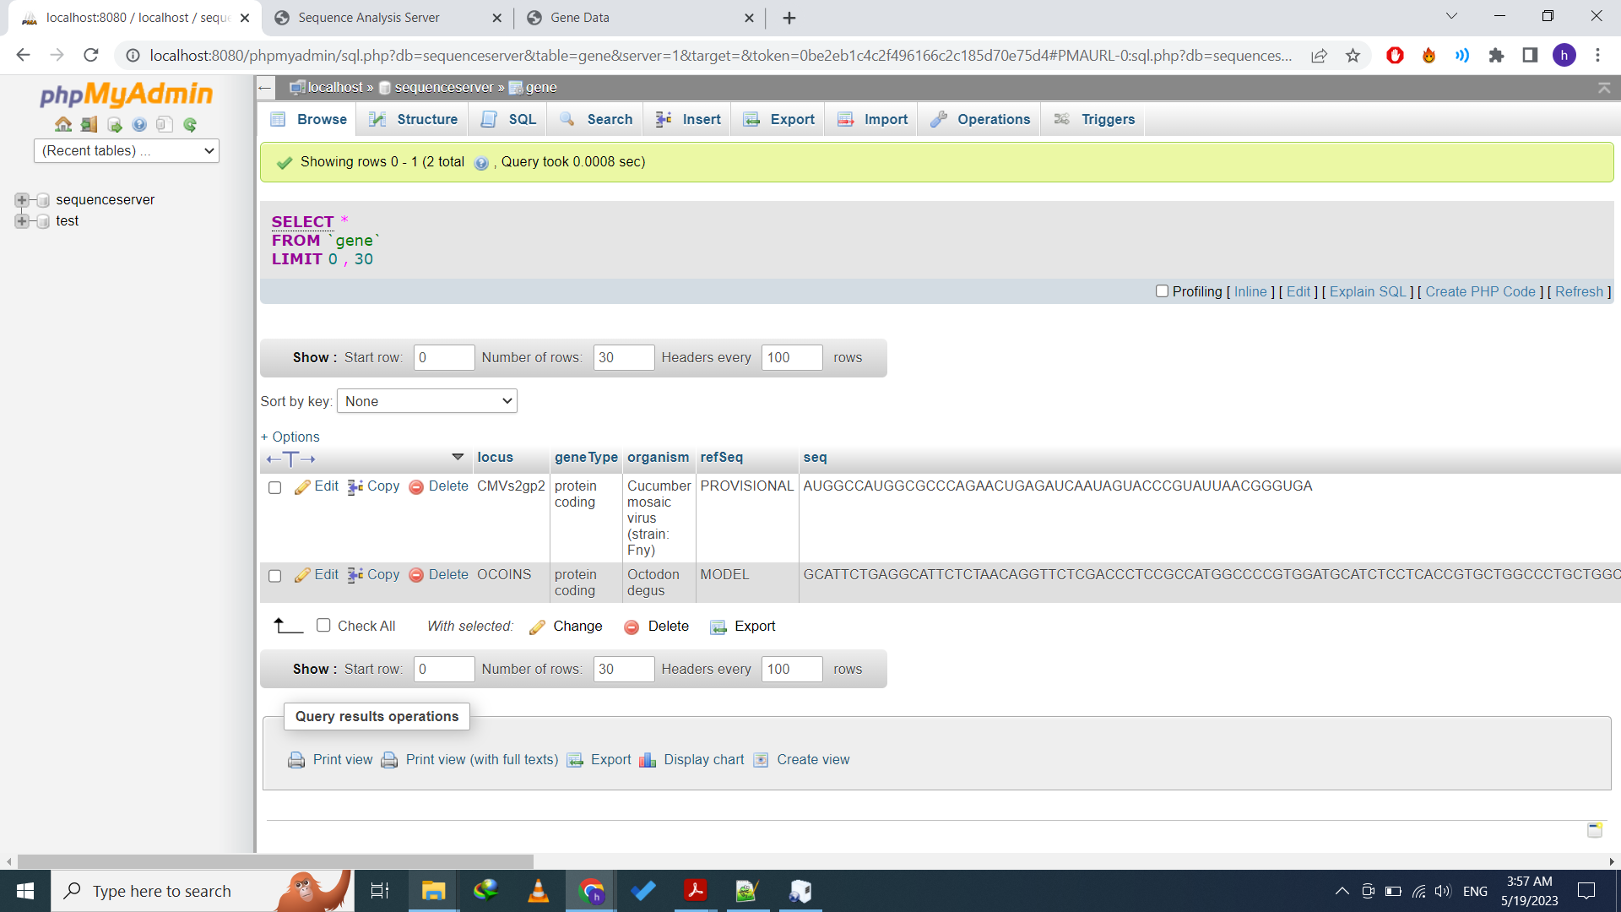
Insert function:
The INSERT function is used to insert new records in a table. :
Gene
Protein
Example of Inserting of a new record (gene):

Slide 7
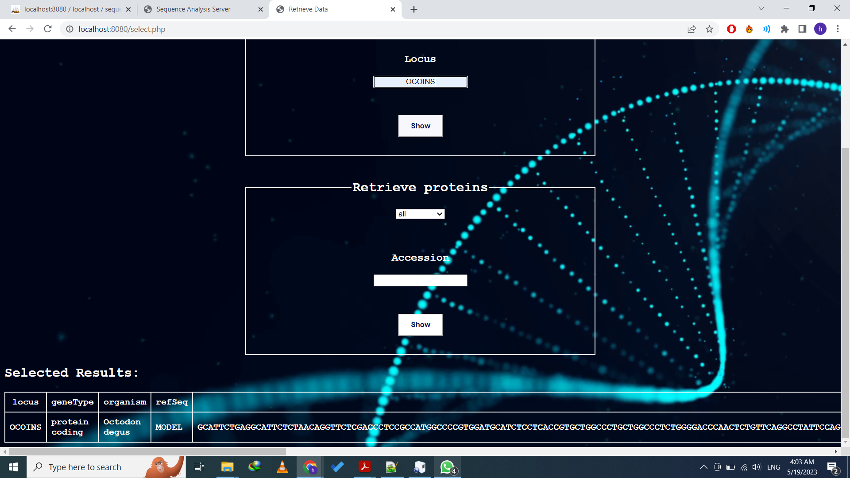
Select function:
The SELECT function is used to retrieve data from a database.. :
Gene
Protein
Example of retrieving data(gene):

Slide 8
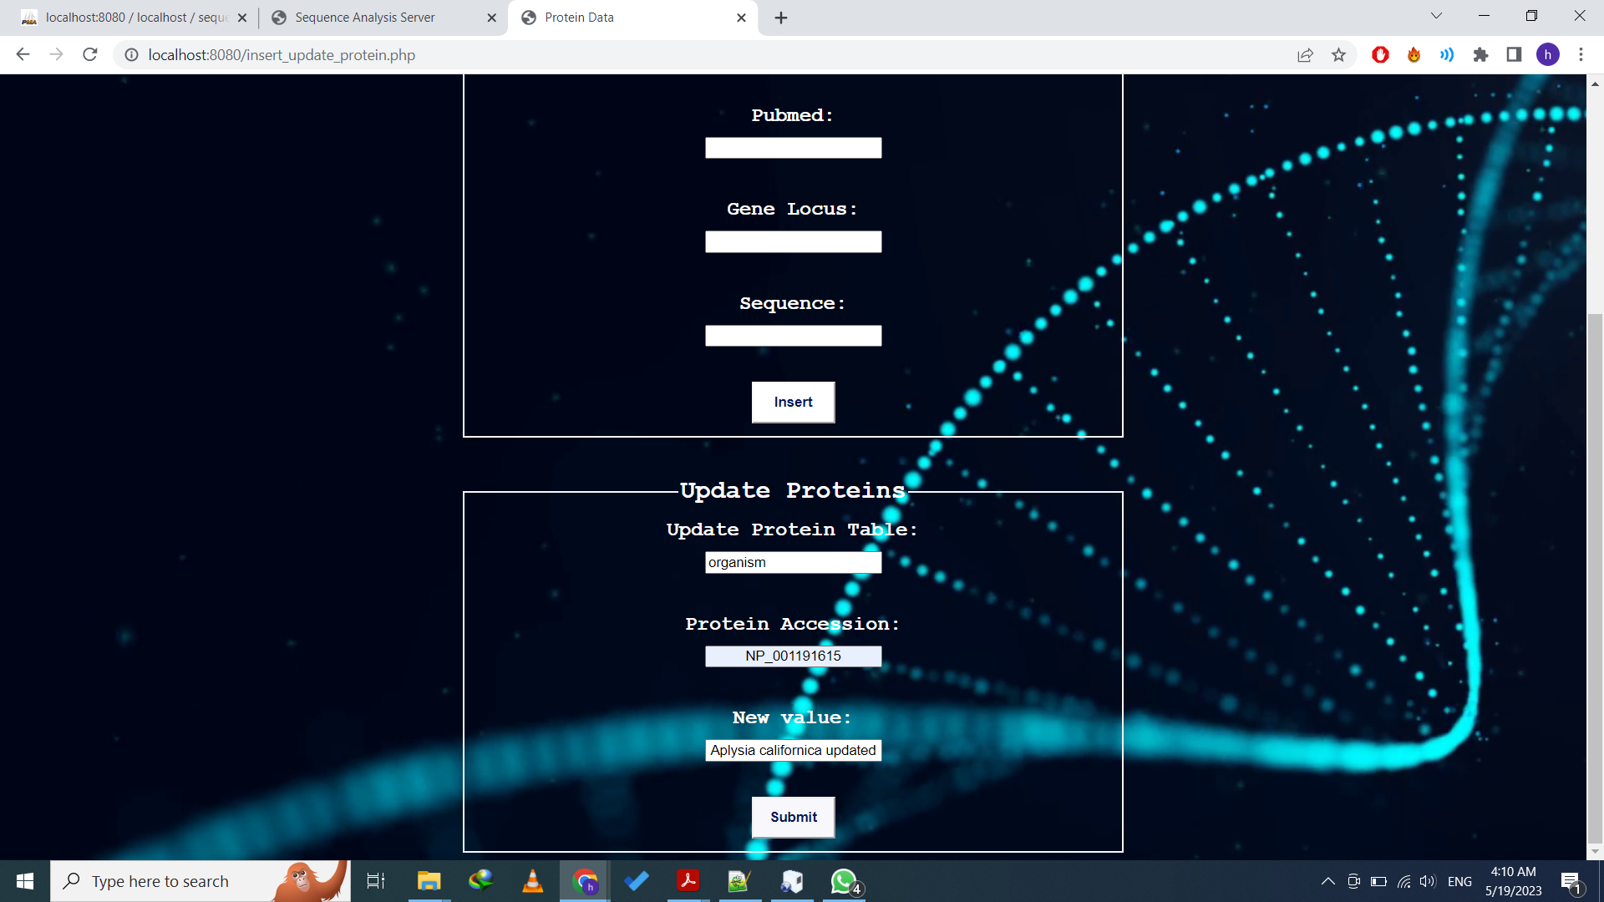
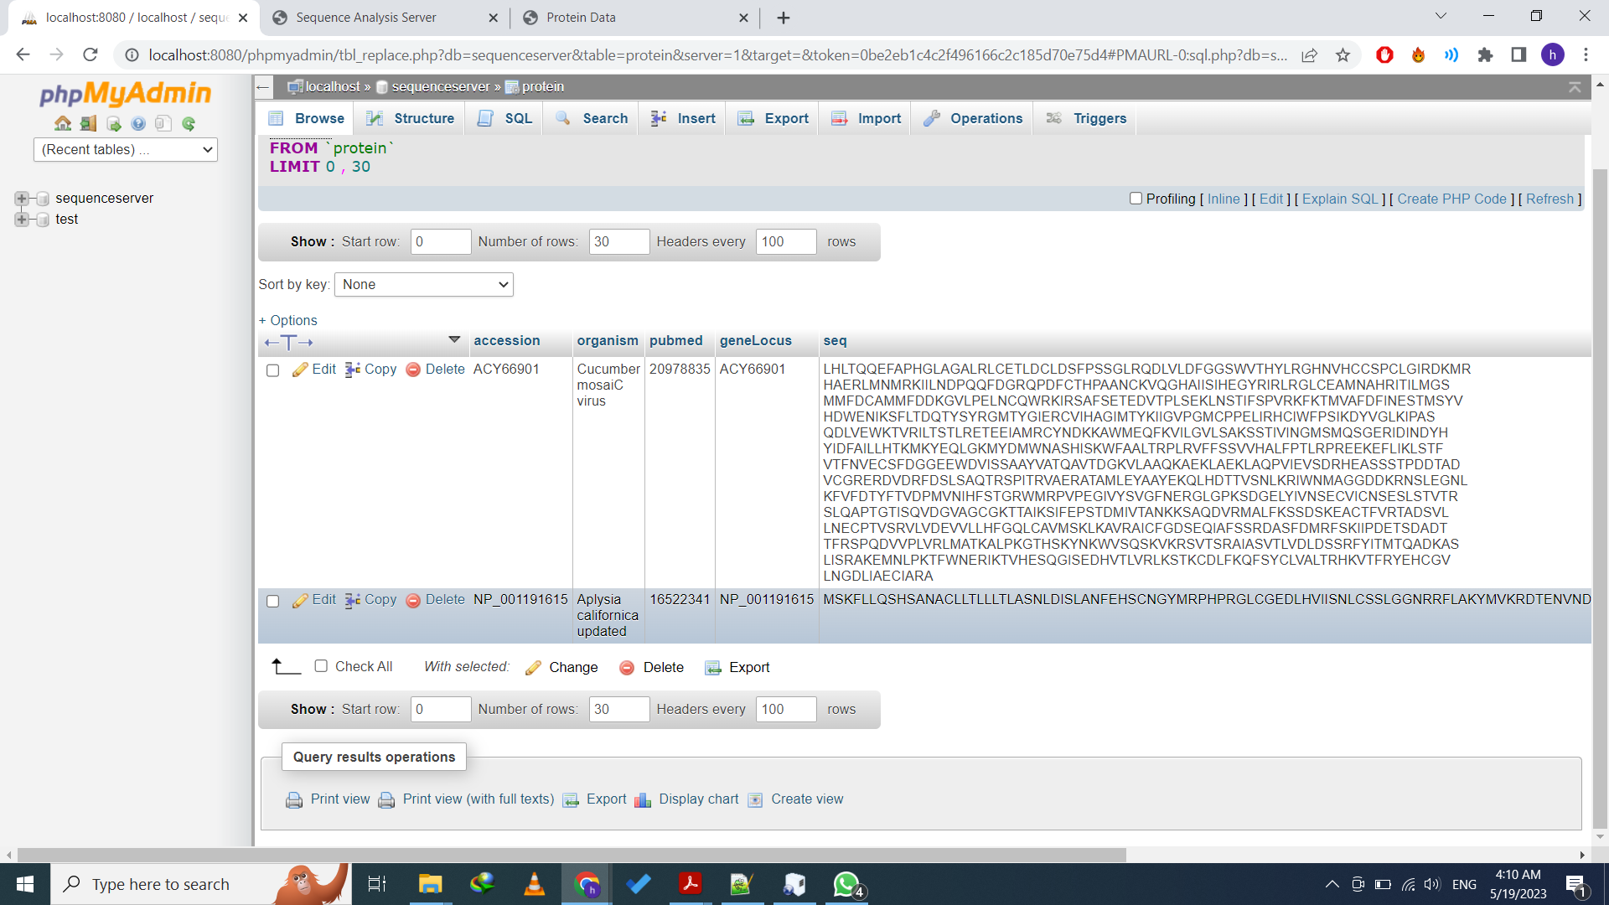
Update function :
The UPDATE function is used to modify the existing records in a table.. :
Gene
Protein
Example of Inserting of a new record (protein):

Slide 9
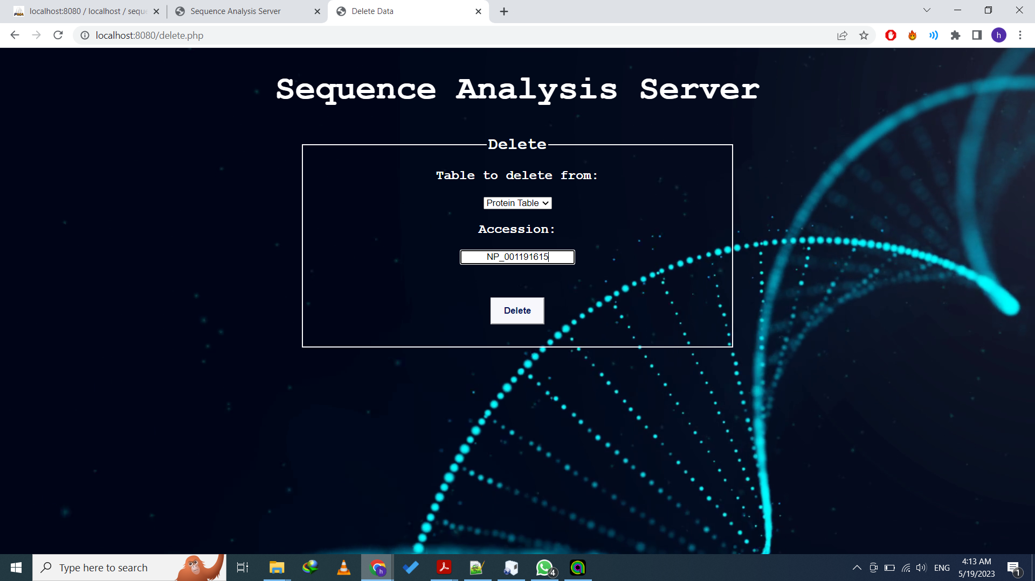
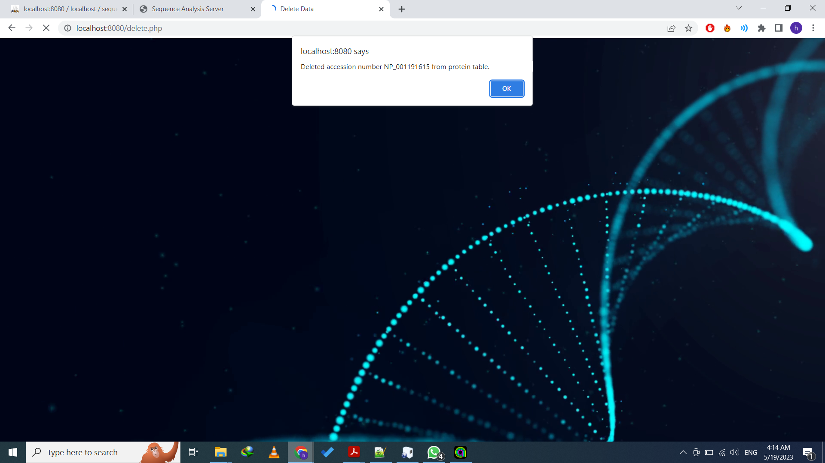
Delete function :
The DELETE function is used to delete existing records in a table.:
Gene
Protein
Example of Inserting of a new record (protein):

Slide 10
Biological Functions

Slide 11
Biological Function
:
GC-Content
GC-content is the percentage of nitrogenous bases in a DNA or RNA molecule that are either guanine (G) or cytosine (C)
Our function takes a DNA or RNA sequences as an input and calculate the percentage of the GC-content in it.
((Count of G-bases + Count of C-bases)/Total Number of all bases) *100
Transcription:
DNA transcription is a process that involves transcribing genetic information from DNA to RNA.
Our function takes a DNA sequence and convert it into a single stranded RNA sequence.
Simply we get the complementary of each nucleotide with replacing T (Thymine) with U(Uracil) (G→C) (A→U).

Slide 12
Biological Function
N-bases
N-bases is the percentage of the N-bases in a DNA or RNA sequences.
Our function takes a DNA or RNA as an input and calculate the N-bases percentage.
(Total number of N-bases/ Total number of all bases) *100
Protein Translation:
Translation of the mRNA converts nucleotide genetic information into the “language” of amino acids to create a protein product.
Each amino acid is defined within the mRNA by a triplet of nucleotides called a codon.
Here in our function, it could either take a DNA single strand and transcribe into m-RNA then translate it to sequence of Amino acids -or take a m-RNA directly and translate it.

Slide 13
Biological Function
Most repeated K-MER:
we assumed that our k equals 3.
Given a sequence of nucleotides, it gets the 3-mer that's most frequent.
Complementary DNA:
This function gets the complement of each nucleotide in a given sequence.
As we know the complementary of each nucleotide is : A-T, G-C

Slide 14
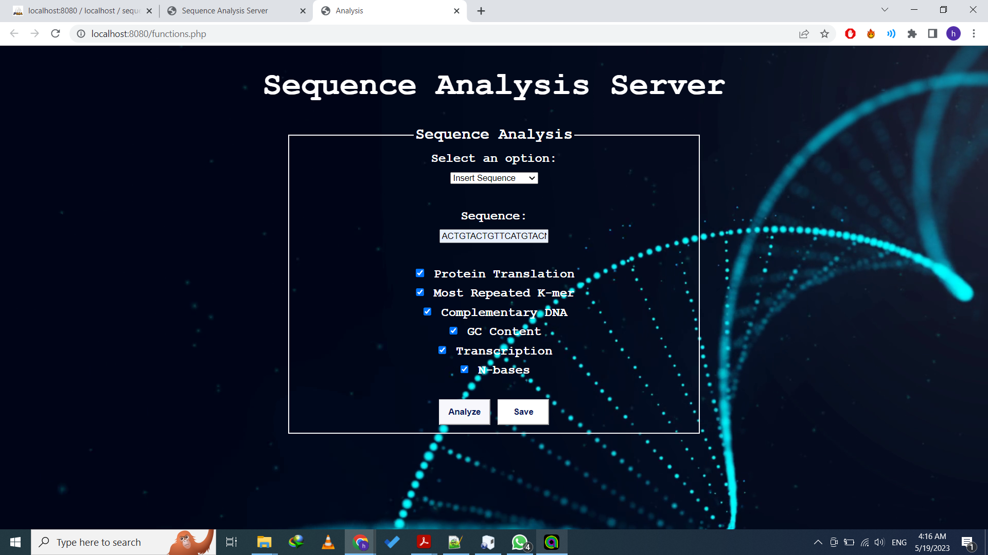
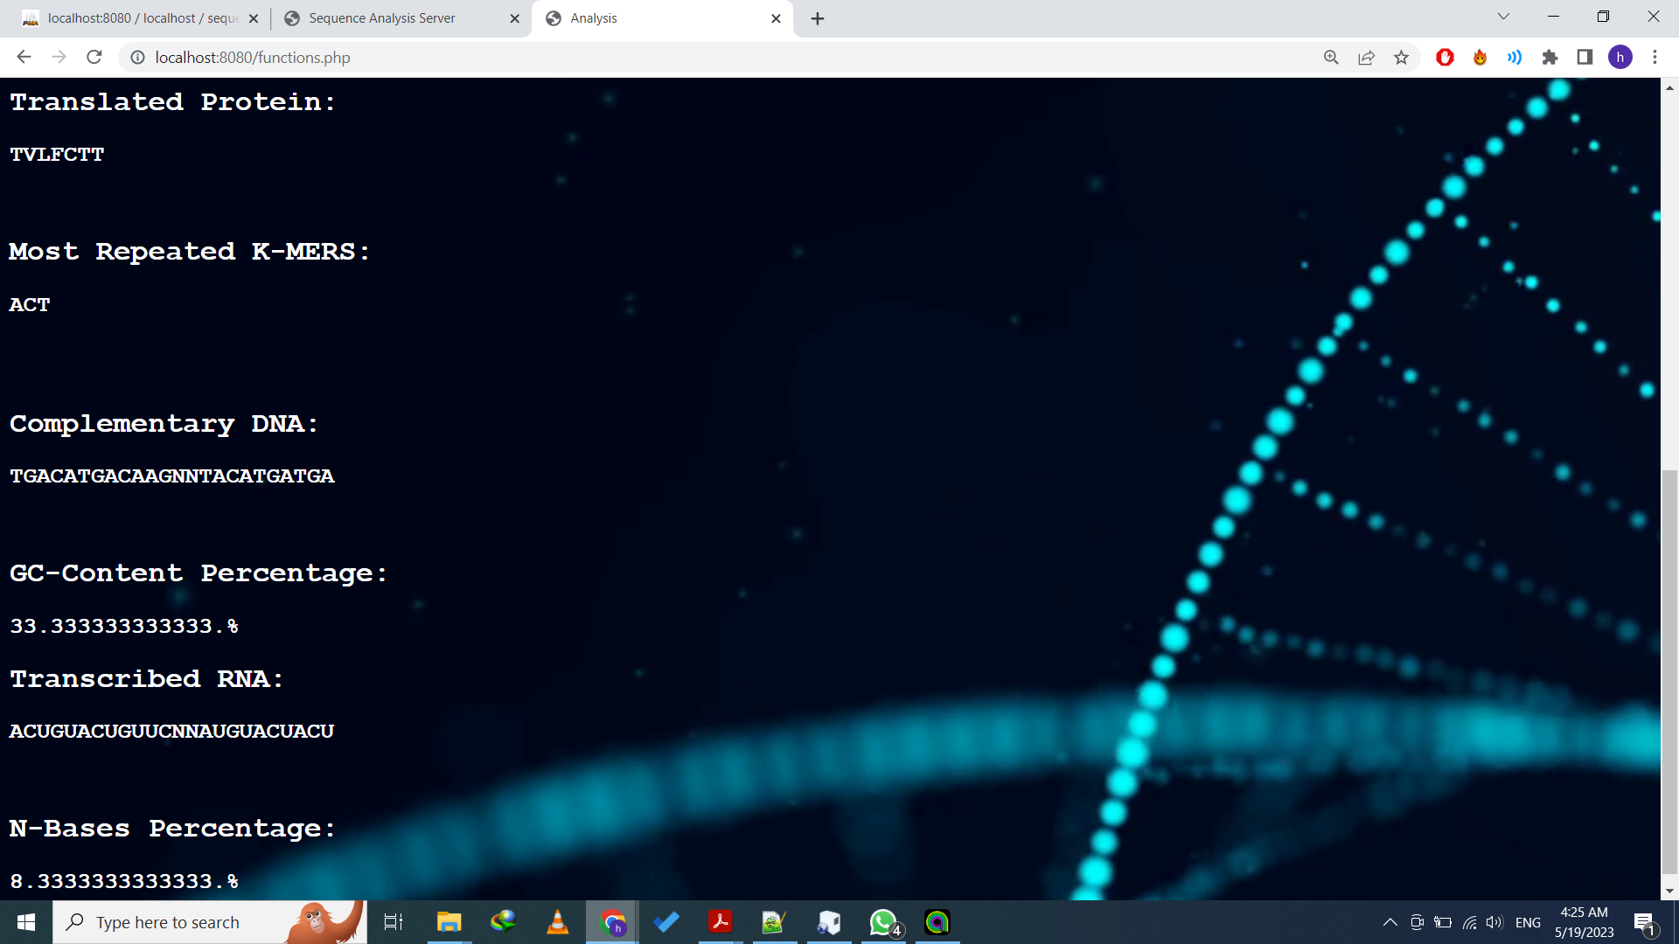
Biological Function
Snapshot of the functions:

